Slide 1
PaViz: A Power-Adaptive Framework for Optimizing Visualization Performance
EGPGV, Barcelona, Spain
Stephanie Labasan, Lawrence Livermore, Univ of Oregon
Matthew Larsen, Hank Childs, and Barry Rountree
June 12-13, 2017

Slide 2
This study was motivated by the power limitations at exascale
Goal: Improve power utilization to maximize performance in a power-constrained environment
Method: Enforce power caps, affecting the CPU frequency and voltage
Proposition for users: Slow down some nodes in order to speed up other nodes, improving overall execution time
Study: Use a performance model for rendering to dynamically rebalance power to where it will do the most good

Slide 3
Presentation Outline
Background
PaViz and Research Questions
Study Overview
Results
Takeaways

Slide 4
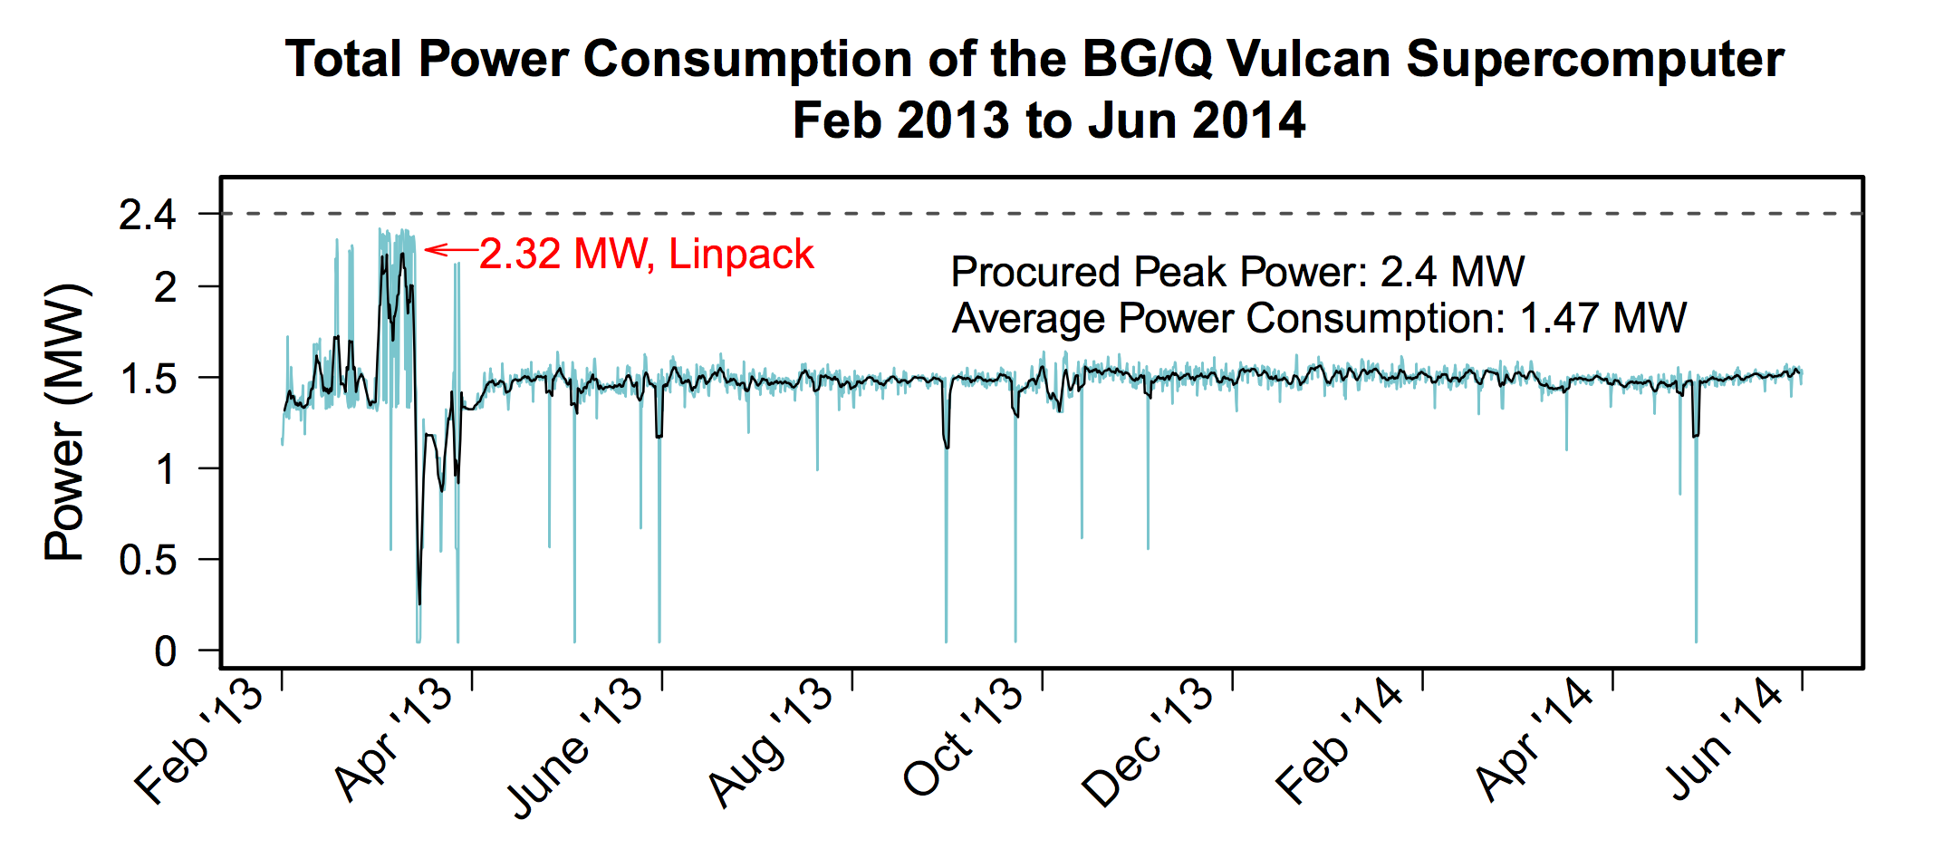
Current system power utilization is sub-optimal
2.4 MW:
Assumes all nodes consume peak power at the same time
1 MW, Un-used!
1.47 MW, Other codes
Limits the size of the system, reducing system throughput
Power capacity left on the table, more science could be done
Wasted money spent on infrastructure
c/o T Patki
Notes:
Linpack is a highly compute-intensive benchmark solving linear equations, designed to stress test every component of the system.

Slide 5
U.S. Department of Energy’s perspectives on exascale challenges
Systems | 2009 | “2018” “2023” | Difference Today & 2018 2023
System peak | 2 Pflop/s | 1 Eflop/s | O(1000)
Power | 6 MW | 20 MW | ~3-5
System memory | 0.3 PB | 32-64 PB [.03 Bytes/Flop] | O(100)
Node performance | 125 GF | 1,2 or 15 TF | O(10)-O(100)
Node memory BW | 25 GB/s | 2- 4 TB/s [.002 Bytes/Flop] | O(100)
Node concurrency | 12 | O(1k) or 10k | O(100)-O(1000)
Total Node Interconnect BW | 3.5 GB/s | 200-400GB/s | O(100)
System size (nodes) | 18,700 | O(100,000) to O(1M) | O(100)-O(1000)
Total Concurrency | 225,000 | O(billion) [O(10) to O(100) for latency hiding] | O(100)
Storage | 15 PB | 500-1000 PB (>10x system memory in min) | O(10)-O(100)
IO | 0.2 TB | 60 TB/s (how long to drain the machine) | O(100)
MTTI | Days | O(1 day) | - O(10)
Systems | 2009 | “2018” “2023”
System peak | 2 Pflop/s | 1 Eflop/s
Power | 6 MW | 20 MW
Hardware innovations have been the primary solution for power savings. However, to reach 1 Exaflop at the desired power budget, software improvements may be necessary.
c/o P Beckmann

Slide 6
Power on future exascale supercomputers
Two scenarios
System peak power consumption is < 20 MW
i.e., even Linpack stays below this limit
Poor power utilization
System peak power consumption is > 20 MW
Controls needed to enforce power usage at 20 MW power cap
Central manager coordinates power allocations
Better power utilization and more science completed
20
←
Linpack
Time
?
←
Linpack
20
Time
Notes:
Second figure shows system power consumption if we did NOT coordinate power allocations.

Slide 7
Improve power utilization with overprovisioning
Increase compute capacity by adding more nodes
Limit power per node
?
←
Linpack
20
Time
Not all nodes can run at max power simultaneously – bad for Linpack
All nodes can be run at (say) 50% power – great for common use case
The entire HPC ecosystem will need to adapt to these constraints, including visualization and analysis routines.
c/o B Rountree
Notes:
The power in HPC community has advocated for overprovisioning as the solution for improving power utilization in exascale systems.

Slide 8
Presentation Outline
Background
PaViz and Research Questions
Study Overview
Results
Takeaways

Slide 9
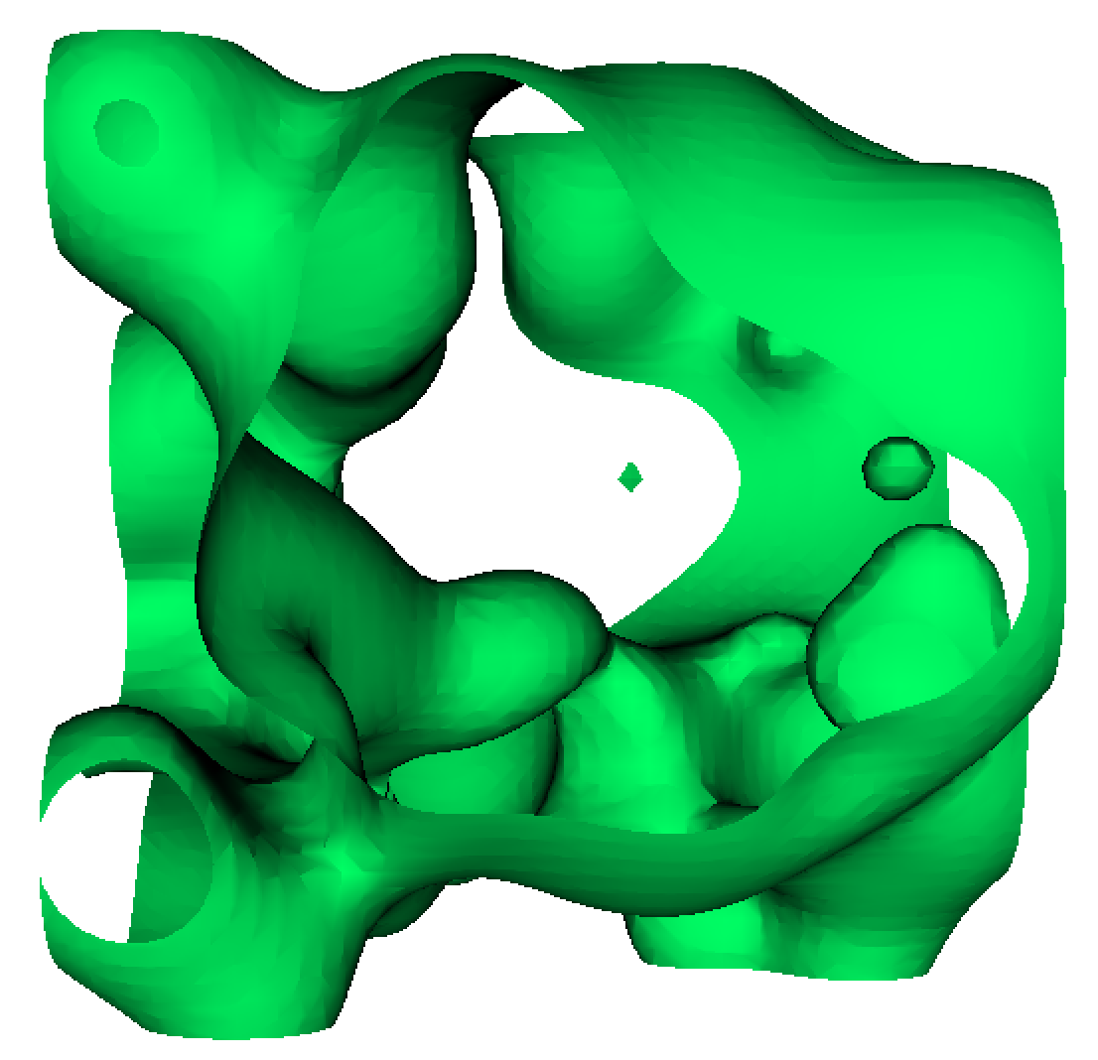
Imbalance in visualization routines poses an opportunity for performance improvements
Canonical example = isosurfacing
Geometry (i.e., work) will not be symmetrical
Work per node will vary...some nodes will have lots of work, others with no work
Give power to rank with lots of work
Take power away from rank with less work
Improve overall runtime
Ranks with less work
Rank with lots of work

Slide 10



Imbalance in visualization routines poses an opportunity for performance improvements
Canonical example = isosurfacing
Geometry (i.e., work) will not be symmetrical
Work per node will vary...some nodes will have lots of work, others with no work
Give power to rank with lots of work
Take power away from rank with less work
Improve overall runtime
Power
5
5
5
= 15
Notes:
In this example, we zoom in on three ranks with varying amounts of geometry. Our current strategy allocates uniform power to all ranks. In this example, we have a total of 15W, 5W per node.

Slide 11
Imbalance in visualization routines poses an opportunity for performance improvements
Canonical example = isosurfacing
Geometry (i.e., work) will not be symmetrical
Work per node will vary...some nodes will have lots of work, others with no work
Give power to rank with lots of work
Take power away from rank with less work
Improve overall runtime
So, which ranks have more work and which have less?
We need to know this before they start executing.
Idea: Let’s use performance modeling!
9
Power
4
= 15
2

Slide 12
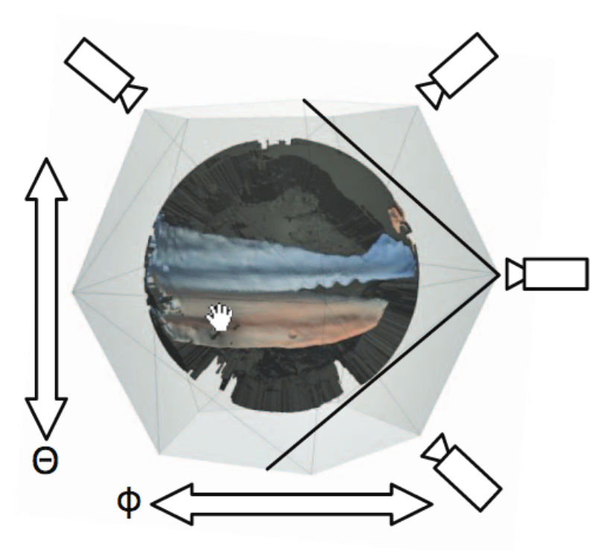
PaViz: Power-Aware Visualization Runtime Framework
This study: PaViz
Software power-aware runtime framework
Uses predicted execution times per node to assign a schedule of power allocations
System focus is on rendering
Incorporates existing performance model
Key phase in the visualization pipeline
Typically a very fast operation, but could be very time-consuming (CINEMA)
Ahrens et. al “An image-based approach to extreme scale in situ visualization and analysis”
Notes:
Our system focuses on rendering. We incorporate an existing performance model. Rendering is a key phase in the visualization pipeline and is typically a very quick operation, but could be very time-consuming, if we consider the CINEMA use case where you render many images from many camera positions.

Slide 13
Putting It All Together
Visualization + overprovisioning merits special attention
Why? Visualization workloads are imbalanced and irregular
→ Need visualization-centric techniques to thrive in this constrained environment
Research Question: Can additional performance be gained by leveraging performance models for visualization algorithms?
Idea: Alter per node power allocations based on predicted runtime
Notes:
Visualization and analysis in an overprovisioned environment merits special attention.

Slide 14
Presentation Outline
Motivation
PaViz and Research Questions
Study Overview
Results
Takeaways

Slide 15
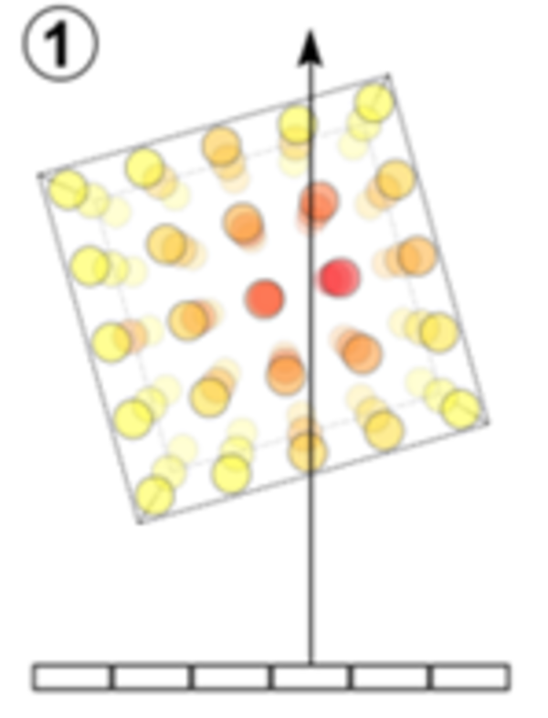
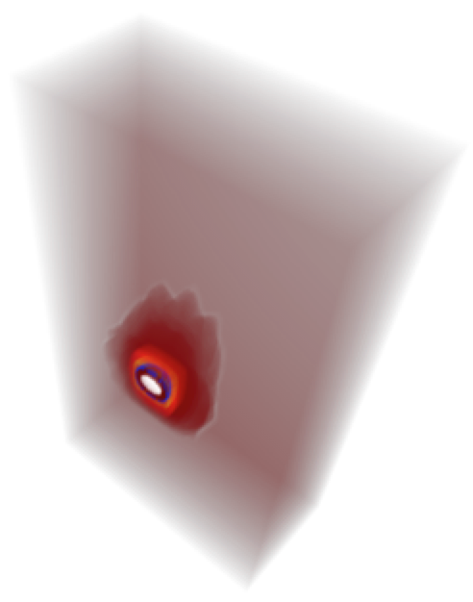
Performance Factors for Volume Rendering
Image-order algorithm
For each pixel, trace a ray through the volume and sample at regular intervals
Volume rendering performance is influenced by three key factors:
Number of unique cells sampled
Total number of samples
Number of pixels in image vs. number of active pixels
x
Image Size
x
Active Pixels
x
x
Sample Along The Ray
Screen Space Bounding Box
c/o M Larsen
Notes:
Volume rendering is an image-order algorithm. So for each pixel, we trace a ray through the volume and sample at regular intervals.
Cell frequency = for each unique cell sampled, load in the coordinate and scalar values
Interpolate scalars to sample location, blend colors

Slide 16
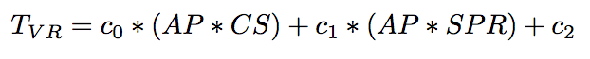
Volume Rendering Performance Model
Predicted time to complete volume rendering per node:
AP = number of active pixels
CS = number of cells spanned
SPR = samples per ray
Cell Frequency
Sample Frequency
Larsen et al. “Performance Modeling of In Situ Rendering”. SC16
Notes:
Our study used an existing performance model for volume rendering developed by Larsen et. al. The model predicts the performance of volume rendering on each node.

Slide 17
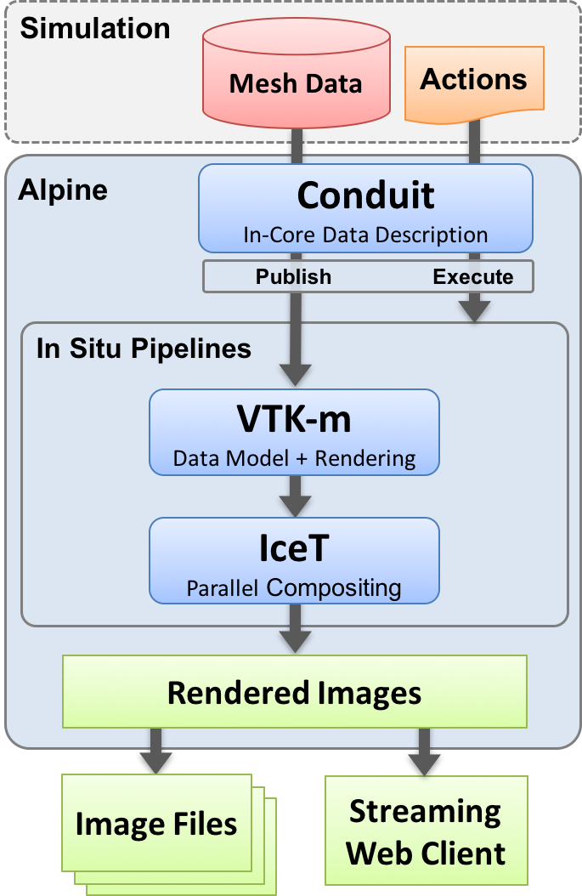
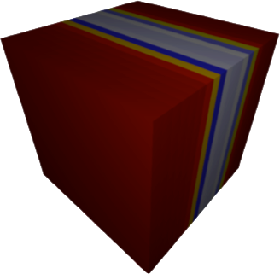
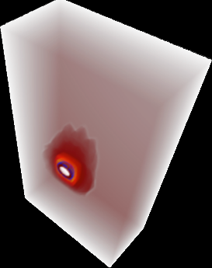

Strawman
In situ visualization infrastructure connecting simulation to visualization
Coupled with (3) proxy applications, CloverLeaf3D, Kripke, and Lulesh
DOE Exascale Computing Project Alpine: https://github.com/alpine-dav/alpine
Larsen et al. “Strawman: A Batch In Situ Visualization and Analysis Infrastructure for Multi-Physics Simulation Codes”. ISAV15
Notes:
Atomic Weapons Establishment (AWE) Cloverleaf3D: hydrodynamics simulation

Slide 18
Hardware Architecture
LLNL’s Catalyst supercomputer
Dual socket nodes containing Intel Ivy Bridge CPUs each with 12 hyper-threaded cores
Nominal CPU frequency of 2.4 GHz
Peak power draw of 115W
CPU power cap with Intel’s Running Average Power Limit (RAPL)
Over a given time window, the average power usage will not exceed the specified power cap
Underlying firmware dithers CPU operating frequency and voltage
LLNL’s msr-safe kernel (https://github.com/llnl/msr-safe) enables setting power caps from userspace
Notes:
We set processor power caps using Intel's RAPL. This technology guarantees that over a given time window, the average power usage will not exceed the desired power cap.
Setting power caps is traditionally a priviledged operation, but with LLNL's msr-safe kernel module, we can set power caps from user space.

Slide 19
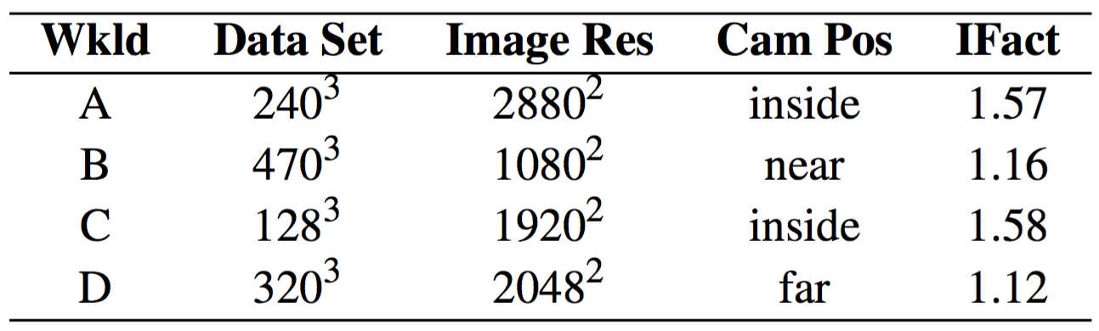

Study Overview
Imbalance Factor
Rendering workload
Camera position affects imbalance level
Imbalance Factor = max runtime/min runtime
High Imbalance Factor = more imbalanced
Rank
Camera far: All ranks have work to do
Camera inside: Imbalanced work
Far
Near
Inside

Slide 20
Study Overview
Rendering workload
MPI task concurrency
One MPI task per node for maximum memory partition
8 tasks (ranks) = 192 cores
64 tasks (ranks) = 1,472 cores

Slide 21


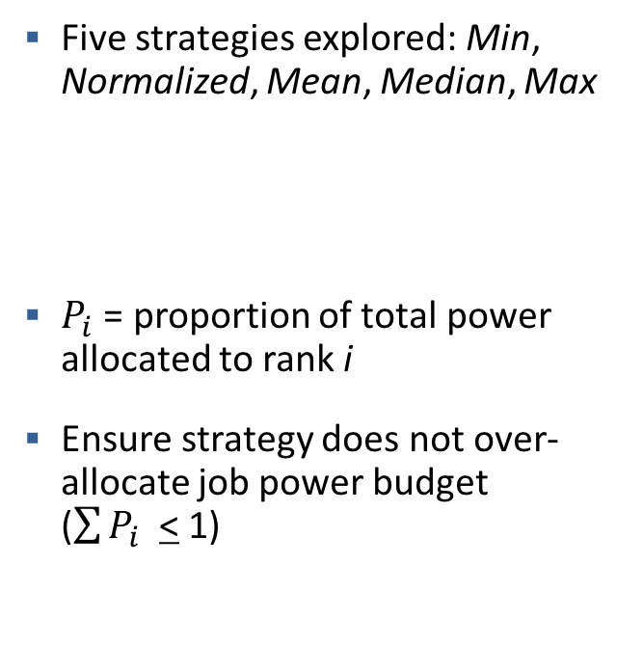
Study Overview
Rendering workload
MPI task concurrency
Power scheduling strategy
Five strategies explored: Min, Normalized, Mean, Median, Max
$P_{i}$ = proportion of total power allocated to rank i
Ensure strategy does not over-allocate job power budget ($\sum{P_{i} }$< 1)
Min
$$P_{i}=\frac{t_{i}−t_{min}}{\sum{t_{i}−t_{min}}}$$
Normalized
$$P_{i}=\frac{t_{i}}{\sum{t_{i}}}$$
See this paper for details of other power scheduling strategies.

Slide 22
Study Overview
Rendering workload
MPI task concurrency
Power scheduling strategy
Job power budget
8 nodes : 1,840W → 1,024W
64 nodes : 14,720W → 8,192W
*1 MPI task per node
CPU0
CPU1
115W → 64W
5W increments
115W → 64W
5W increments
Node
: 230W → 128W
Supercomputer is not overprovisioned.
However, we artificially limit the power per node to simulate an overprovisioned environment.

Slide 23
Methodology
Rendering workload
MPI task concurrency
Power scheduling strategy
Job power budget
Study conducted in 4 phases
Phase 1: Vary job power budget for a single rendering workload, 8 MPI tasks, Min power scheduling strategy
Each phase varies 1 factor to explore effects

Slide 24
Presentation Overview
Background
PaViz and Research Questions
Study Overview
Results
Takeaways

Slide 25
Phase 1 Results: Vary Job Power Budget
10% speedup in execution time by redistributing power to nodes with more work.
This is comparing to current strategy of uniform power distribution across nodes.
Reducing job power budget, more severe power cap
Camera Inside

Slide 26
Phase 2 Changes
Changes: Compare Min strategy from previous phase with remaining power scheduling strategies on Rendering Workload A
Goal: Explore the effects of each strategy on an imbalanced workload

Slide 27
Phase 2 Results: Vary Power Scheduling Strategy
Min and Normalized scheduling strategies perform best under power constraints and in an imbalanced workload.
Compare all scheduling strategies.
Camera Inside

Slide 28
Phase 3 Changes
Changes: Compare all (5) power scheduling strategies on all rendering workloads
Goal: Explore the effects of each strategy on workloads of varying imbalance levels
Figures for remaining phases are not meant to be readable. I will summarize the findings.

Slide 29
Phase 3 Results: Vary Rendering Workload Configuration
Less benefit when the workload is balanced (Workloads B and D).

Slide 30
Phase 4 Changes
Changes: Repeat previous phase at 64 node concurrency
Goal: Explore the effects at higher scale

Slide 31
Phase 4 Results: Vary Concurrency
Up to 33% speedup at higher concurrencies on imbalanced workloads (Workloads A and C). Could not scale up larger due to software limitations. Planning to address this in future work.
64 Nodes

Slide 32
Presentation Overview
Background
PaViz and Research Questions
Study Overview
Results
Takeaways

Slide 33
Conclusion and Future Work
We present PaViz, a power-adaptive framework for optimizing visualization performance
Using prediction to re-allocate power among nodes in a job can result in up to 33% speedup over current strategy while using the same power overall
Future Work
Can additional performance be realized at higher concurrencies?
How will performance models for other algorithms fare?
How does PaViz compare to state-of-the-art runtime systems, such as Intel’s GEOPM?

Slide 34
Thank you!
We present PaViz, a power-adaptive framework for optimizing visualization performance
Using prediction to re-allocate power among nodes in a job can result in up to 33% speedup over current strategy while using the same power overall
Future Work
Can additional performance be realized at higher concurrencies?
How will performance models for other algorithms fare?
How does PaViz compare to state-of-the-art runtime systems, such as Intel’s GEOPM?
“PaViz: A Power-Adaptive Framework for Optimizing Visualization Performance”
Stephanie Labasan (labasan1@llnl.gov)

